Slide 2
Learning by Exploration
Qingyun Wu, Huazheng Wang, Hongning Wang
Department of Computer Science
University of Virginia

Slide 3
Outline of this tutorial
Motivation
Classical exploration strategies
Efficient exploration in complicated real-world environments
Exploration in non-stationary environments
Ethical considerations of exploration
Conclusion & future directions

Slide 4
“Intelligent” systems
Check media feeds
Automated vehicles
Attend to emails
Find a restaurant
Online shopping
Entertainment
Career Development
Online Education
Digital Health

Slide 5
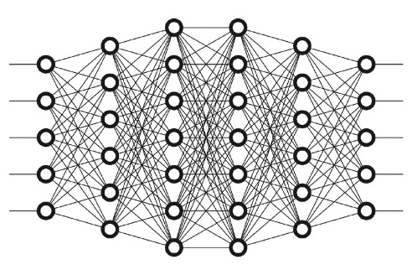
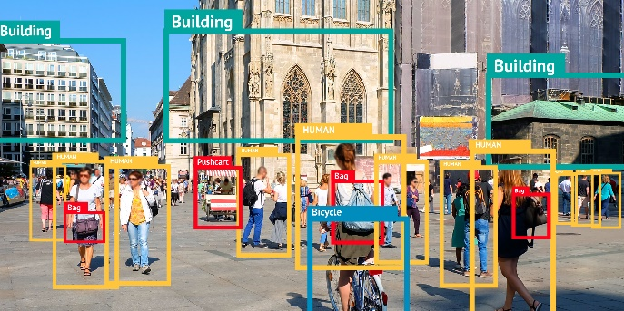
Supervised machine learning
Training
Inference
The agent only learns what is already in the data; it does not know what is not there!

Slide 6
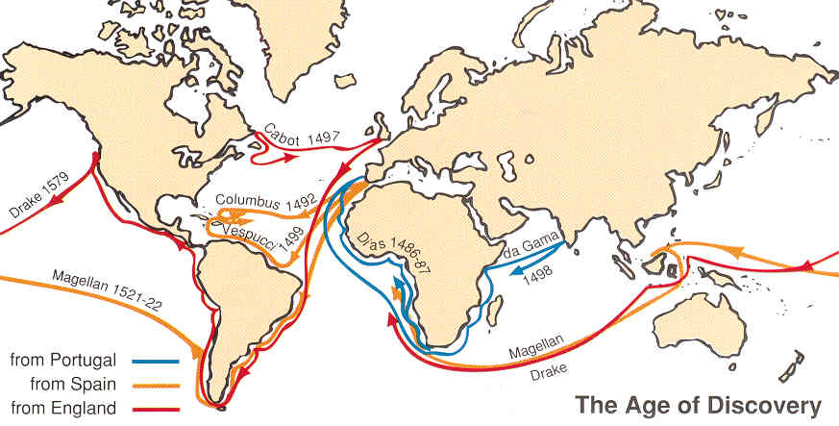
Learning by exploration

Slide 7
Learning by exploration
Horror
Romance
Drama
Figure credit: Schnabel et al. 2016 ^{[SSSCJ16]}
Matthew effect: we still don’t know what we don’t know!

Slide 8
Learning by exploration is challenging
Huge search space
Exploration is costly

Slide 9
Learning by exploration is challenging
One only gets answers to the questions she asked
Bandit (implicit) feedback
Horror
Romance
Drama

Slide 10
Learning by exploration is challenging
One only gets answers to the questions she asked
Bandit (implicit) feedback
Efficient exploration is critical

Slide 11
Learning by exploration is challenging
The problem space can be structured
The observations might not be independent
Clustered, correlated responses?
Horror
Romance
Drama
Social influence?
Figure credit: Schnabel et al. 2016 ^{[SSSCJ16]}

Slide 12
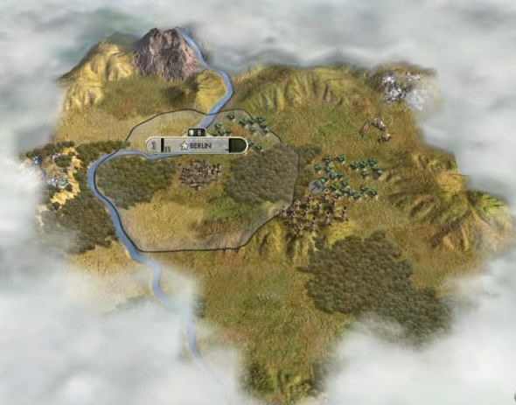
Learning by exploration is challenging
The problem space is evolving over time
A non-stationary learning environment
Recognize outdated model is important

Slide 13
Learning by exploration is challenging
There are also safety, privacy, and ethic concerns in exploration

Slide 14
Outline of this tutorial
Motivation
Classical exploration strategies
Efficient exploration in complicated real-world environments
Exploration in non-stationary environments
Ethical considerations of exploration
Conclusion & future directions

Slide 15
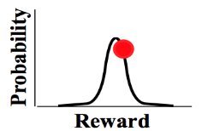
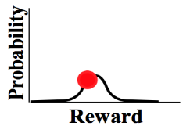
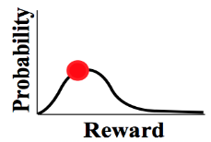
Problem formulation
Adversarial bandit is out of scope of this tutorial
(stochastic) Multi-arm bandit
…
Goal: maximize the accumulated reward over T rounds
Reward distribution
(Pseudo) Regret: expected loss due to not playing the best arm
…
Actions
Regret
Agent/learner/policy
Reward
Lower regret bound [LR85]:
Lower regret bound [Aue95]:
Time
History
Finite variance is required!
Sub-linear regret is preferred!
Difficulty of the problem

Slide 16
Problem formulation
In linear contextual bandit [LCLS10],
Contextual/structured bandit
…
Goal: maximize the accumulated reward over T rounds
Reward distribution
(Pseudo) Regret: expected loss due to not playing the best arm
…
Actions
Agent/learner/policy
Reward
Lower regret bound in linear contextual bandit [CLRS11]:
History

Slide 17
Problem formulation
Out of scope of this tutorial
Reinforcement learning [SB18]
State
Reward
Action

Slide 18
Problem formulation
In linear contextual bandit [LCLS10],
Ridge regression, closed form solution exists!
Key problems
Reward estimation
Arm selection
Reward
Action
Convergence matters!
Exploration matters!
Multi-arm bandit:
Contextual bandit:
Adaptive v.s., non-adaptive
Independent v.s., collaborative
Unconstrained v.s., constrained
Loss function Regularization

Slide 19
Classical exploration strategies
Random exploration
Optimism in the face of uncertainty
Posterior sampling
Perturbation-based

Slide 20
Random exploration
Lower regret bound of MAB:
Reward estimation in MAB:
Constant leads to linear regret!
$ε$-greedy [Aue02]
By setting , we have
Arm selection
Non-adaptive; often leads to sub-optimal performance in practice.

Slide 21
Random exploration
Epoch greedy [LZ08]
Explore and then commit
Explore by one step
Size of hypothesis space, which makes the exploration adaptive
Length of epoch
Exploit by one epoch

Slide 22
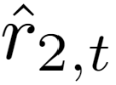
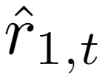
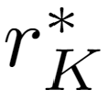
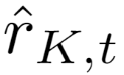
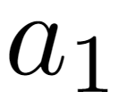
Optimism in the face of uncertainty
Chernoff-Hoeffding bound
Lower regret bound of MAB:
UCB1 [Aue02]
Upper confidence bound based
Reward
Encourage underestimated arms
…

Slide 23
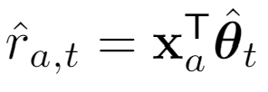
Optimism in the face of uncertainty
Lower regret bound in linear contextual bandit [CLRS11]:
In linear contextual bandit,
LinUCB [LCLS10]
Upper confidence bound based
Confidence ellipsoid
Reward
Encourage underestimated arms
…
Closed form estimator

Slide 24
Optimism in the face of uncertainty
In generalized linear bandit,
In linear contextual bandit [LCLS10],
GLM-UCB [FCGS10]
A generalized linear model
Link function, e.g.,
Confidence ellipsoid
Reward
Encourage underestimated arms
No closed form solution for
…
Using gradient descent to solve
where

Slide 25
Optimism in the face of uncertainty
Lower regret bound of MAB:
KL-UCB [GC11]
Compute upper confidence bound directly
Range of reward
A hyper-parameter
Reward
Encourage underestimated arms
Asymptotically optimal!
…
Intuition:
Pinsker's inequality

Slide 26
Posterior sampling
In linear contextual bandit [LCLS10],
Predictive distribution:
Thompson sampling [AG13]
Source of uncertainty
A Bayesian perspective of reward estimation:
prior
related to prior
Reward
…
Analytic form of posterior
Prior:

Slide 27
Posterior sampling
No formal regret known yet; and some analysis from Bayesian regret perspective
Thompson sampling [RVKOW18]
No analytic posterior?
Approximate posterior inference!
Gibbs sampling
Particle sampling
Laplace approximation
Bootstrapping

Slide 28
Perturbation-based
1) Concentrates at scaled and shifted mean reward;
2) It is an overestimation with a high probability.
Perturbed history exploration [KSGB19a]
Encourage underestimated arms
Reward
Encourage underestimated arms
…
…

Slide 29
Perturbation-based
1) Concentrates at scaled and shifted mean reward;
2) It is an overestimation with a high probability.
Perturbed history exploration [KSGB19b]
With a linear model?
Closed form estimator
00
Reward
…
…
Added reward variance

Slide 30
Perturbation-based
Adversary’s choice, could be adaptive
1) Perturbed adversary
Perturbed adversary [KMRWW18]
How would a greedy solution perform?
2) Diversity
3) Conditional margin
Reward
Encourage underestimated arms
…
Closed form estimator

Slide 31
References I
[SSSCJ16] Schnabel, T., Swaminathan, A., Singh, A., Chandak, N., & Joachims, T. (2016, June). Recommendations as treatments: debiasing learning and evaluation. In Proceedings of the 33rd International Conference on International Conference on Machine Learning-Volume 48 (pp. 1670-1679).
[LR85] Lai, T. L., & Robbins, H. (1985). Asymptotically efficient adaptive allocation rules. Advances in applied mathematics, 6(1), 4-22.
[Aue95] Auer, P., Cesa-Bianchi, N., Freund, Y., & Schapire, R. E. (1995, October). Gambling in a rigged casino: The adversarial multi-armed bandit problem. In Proceedings of IEEE 36th Annual Foundations of Computer Science (pp. 322-331). IEEE.
[LCLS10] Li, L., Chu, W., Langford, J., & Schapire, R. E. (2010, April). A contextual-bandit approach to personalized news article recommendation. In Proceedings of the 19th international conference on World wide web (pp. 661-670).
[CLRS11] Chu, W., Li, L., Reyzin, L., & Schapire, R. (2011, June). Contextual bandits with linear payoff functions. In Proceedings of the Fourteenth International Conference on Artificial Intelligence and Statistics (pp. 208-214).
[SB18] Sutton, R. S., & Barto, A. G. (2018). Reinforcement learning: An introduction. MIT press.
[Aue02] Auer, P. (2002). Using confidence bounds for exploitation-exploration trade-offs. Journal of Machine Learning Research, 3(Nov), 397-422.
[LZ08] Langford, J., & Zhang, T. (2008). The epoch-greedy algorithm for multi-armed bandits with side information. In Advances in neural information processing systems (pp. 817-824).
[FCGS10] Filippi, S., Cappe, O., Garivier, A., & Szepesvári, C. (2010). Parametric bandits: The generalized linear case. In Advances in Neural Information Processing Systems (pp. 586-594).
[GC11] Garivier, A., & Cappé, O. (2011, December). The KL-UCB algorithm for bounded stochastic bandits and beyond. In Proceedings of the 24th annual conference on learning theory (pp. 359-376).

Slide 32
References II
[AG13] Agrawal, S., & Goyal, N. (2013, February). Thompson sampling for contextual bandits with linear payoffs. In International Conference on Machine Learning (pp. 127-135).
[RVKOW18] Russo, D. J., Van Roy, B., Kazerouni, A., Osband, I., & Wen, Z. (2018). A Tutorial on Thompson Sampling. Foundations and Trends® in Machine Learning, 11(1), 1-96.
[KSGB19a] Kveton, B., Szepesvári, C., Ghavamzadeh, M., & Boutilier, C. (2019, August). Perturbed-history exploration in stochastic multi-armed bandits. In Proceedings of the 28th International Joint Conference on Artificial Intelligence (pp. 2786-2793). AAAI Press.
[KSGB19b] Kveton, B., Szepesvari, C., Ghavamzadeh, M., & Boutilier, C. (2019). Perturbed-history exploration in stochastic linear bandits. arXiv preprint arXiv:1903.09132.
[KMRWW18] Kannan, S., Morgenstern, J. H., Roth, A., Waggoner, B., & Wu, Z. S. (2018). A smoothed analysis of the greedy algorithm for the linear contextual bandit problem. In Advances in Neural Information Processing Systems (pp. 2227-2236).

